Slide 1
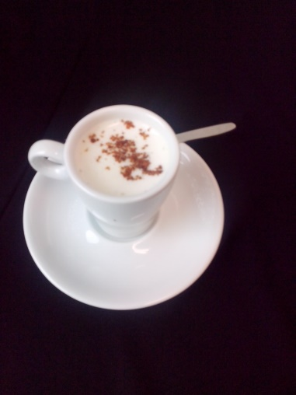
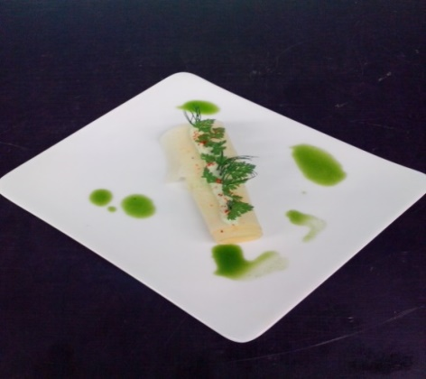
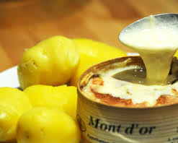
KITCHEN PEDAGOGIQUE/ATELIER PEDAGOGIQUE
Date: Nom: Bruzzese Class/Classe:
APPLICATION OF THE WEEK APPLICATION DE LA SEMAINE
Appetizer of the day Amuse bouche du jour
***
Appenzell cheese
In espuma
Starter/Entrée
***
Swiss cheese cannelloni
(Called Ethivaz)
Main course/plat:
***
Mont D’or cheese
And potatoes

Slide 2
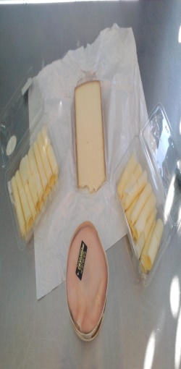
TEACHING KITCHEN /ATELIER PEDAGOGIQUE
Date: Nom: BRUZZESE TEAM/EQUIPE:
APPLICATION OF THE DAY/APPLICATION DU JOUR | PRE-REQUISITE PRES REQUIS | TECHNIQUES OF THE DAY TECHNIQUES DU JOUR | COOKING CUISSON | MATERIALS MATERIELS
Clean and start cooking the potatoes;
Clean on a cold water,
dry and choped fanely the herbs;
Persley,chervil;
-A carving board
-A saucepan
-A pan
- A peeler
-A paring knife
-A chef’s knife
-A spoon
« A
l’anglaise »
Appenzell
cheese
In espuma
-Identify different
areas
and equipment
in a kitchen
Prepare the espuma: blend the cheese
add the hot milk, and the hot cream,
season.
put in the Thermo Whip.
roasting
Swiss cheese
cannelloni
(Called Ethivaz)
-Prepare
the work place
And the knife
Open the vacherin Mont d’or cheese;
make a hole in middle,
add white wine.
Start cooking in the oven.
Mont D’or
Vacherin cheese
and potatoes
-Basic cut
Prepare the whiped cream, add
salt, herbs;
fill the etivaz cheese,
put in a cold place.
Verify potatoes;
prepare, dress the starter

Slide 3
PEDAGOGIQUE KITCHEN /CUISINE PEDAGOGIQUE
EVALUATION
Punctuality and dresscode/Ponctualité et tenue
Regulations and safety/Attitude et posture en cuisine
Hygiene and work-post / Hygiène et poste de travail
Simple and complex techniques
Les techniques simples et complexes
Cookings, finishes and training
Les cuissons les finitions et le dressage
The HACCP method, checking and cleaning
Méthode HACCP vérification et nettoyage

